Slide 1

TRẠNG TỪ LIÊN KẾT
https://langmaster.edu.vn/100-trang-tu-tieng-anh-thong-dung-nhat-a70i1495.html

Slide 2


không giống như mặt khác
1
Unlike on the other hand
/ɒn ði ˈʌðə hænd/
/ʌnˈlaɪk/ -pre
The sound was not unlike
that of birds singing.
My husband likes classical music – I, on the other hand, like all kinds.

Slide 3
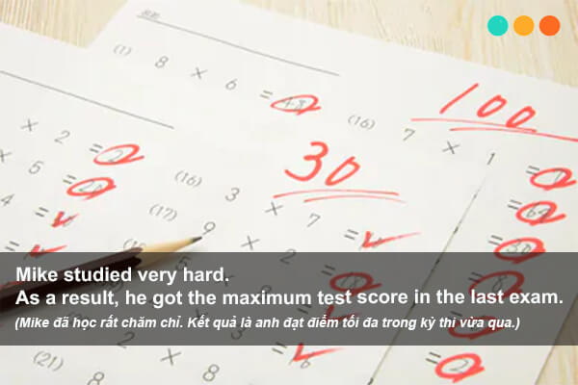
kết quả là hơn nữa
2
furthermore
/ˈfɜːðəˈmɔː/
as a result
/æz ə rɪˈzʌlt/
adv
I finished my work very well. As a result,
I was rewarded by my boss.
The house is beautiful. Furthermore, it's in a great location.
This morning I got up late. As a result,
I was late for school.

Slide 4
hơn nữa
3
Moreover
/mɔːˈrəʊvə/
The rent is reasonable and, moreover, the location is perfect.
Giá thuê hợp lý và hơn nữa, vị trí là hoàn hảo.

